Slide 1

Delivery Velocity
A Comparison of 6 High Production Shipping Centers
W205 Project
Chris Bennett

Slide 2

Speed = Success
Who can produce and deliver mail the fastest?
There are 6 Shipping Centers that account for a majority of production and distribution origination of mail in the US
Previous research has shown that speed of delivery is a primary driver in which company a consumer will choose next time
The East Coast has 1/3 of the US Population, but is slowest to ship to the West Coast - The Middle of the country is more centrally located, but has the fewest nearby consumers.
Until recently, it was difficult to compare shipping speed among the Shipping Centers due to the number of variables (i.e. different products, different customers, different times of the year, et al)

Slide 3
Shipping Center Comparison
Delivering In-home The Fastest
Center 1
Southeast
Center 2
North East
Center 3
East
Center 4
Pacific Coast
Center 5
South Central
Center 6
Central

Slide 4
Research Analysis
Your great subtitle in this line
Company mails 1.3 billion items per year
The work is spread among 6 shipping centers
The items are the same size and weight
Data available includes:
Shipping origin address
Ship to zip code (5-digit)
Days for delivery
We will analyze quantity and speed for mail to each state from each Shipping Ctr with data collected over a 90 day period
Pilot data set ~ 7 million records; full data set ~ 57 million records
Shipping Ctr 1
State
Shipping Ctr 2
...
Shipping Ctr 6

Slide 5



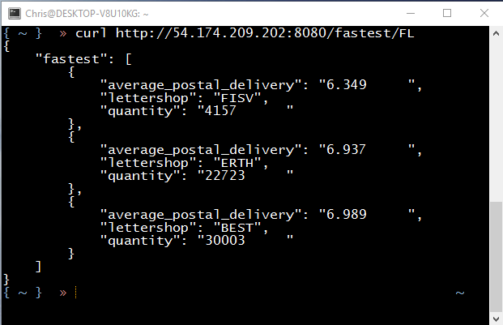






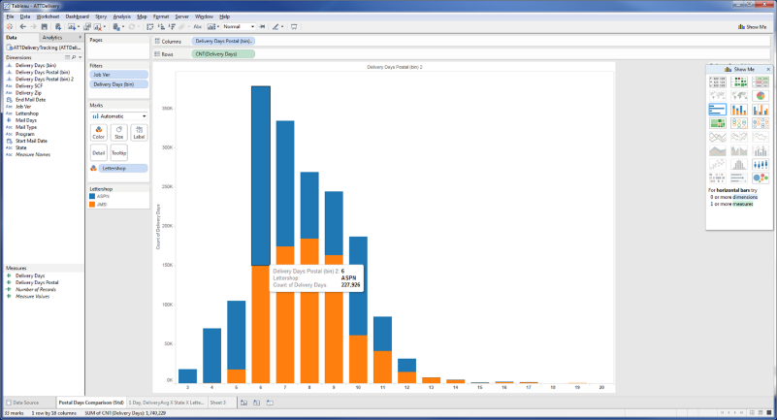
Architecture Diagram
5.1 GB
Barcode #
Lettershop
Delivery Days
Postal Delivery Days
Destination State
Destination Zip
Data Presentation
>1,102
Files
57,788,228
>> curl http://54.174.209.202:8080/fastest/FL
35 MB
Rest API
FTP Server
/stats/<Lettershop>
/fastest/<State>
/statestat/<State>
m1.xlarge
64-bit
4vCPU
15 GB
Create Table as...
LS_Summary_stats
LS_By
Tableau
via Cloudera ODBC
port 10000
,csv
Elastic Block Store
100 GB
3000 IOPS

Slide 6
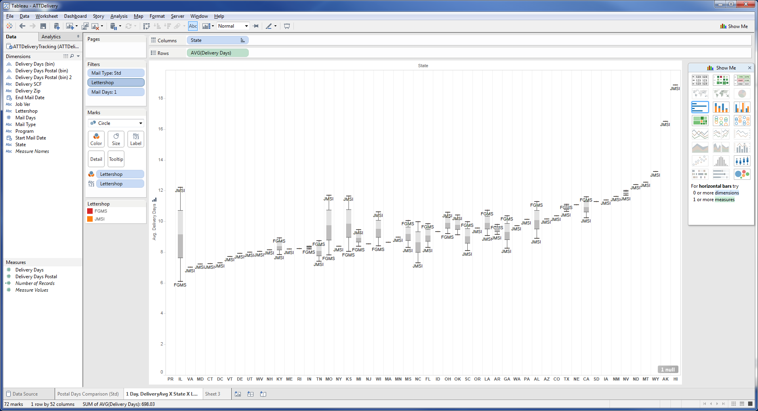
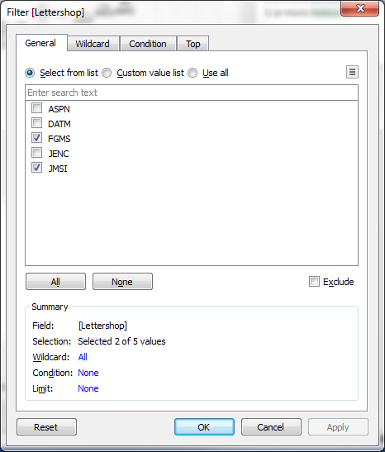
Tableau

Slide 7
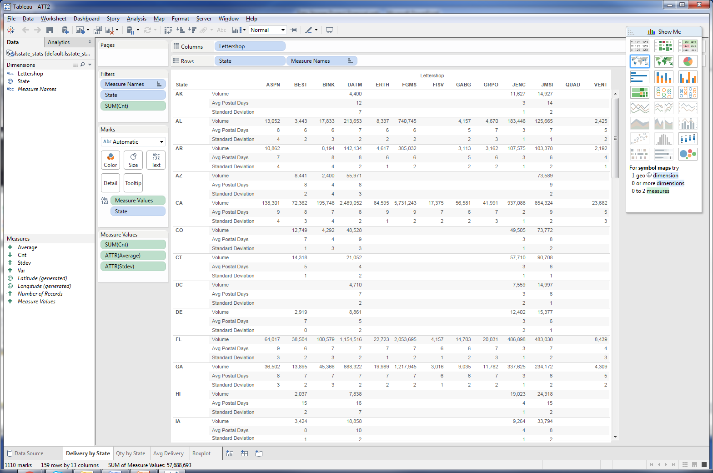
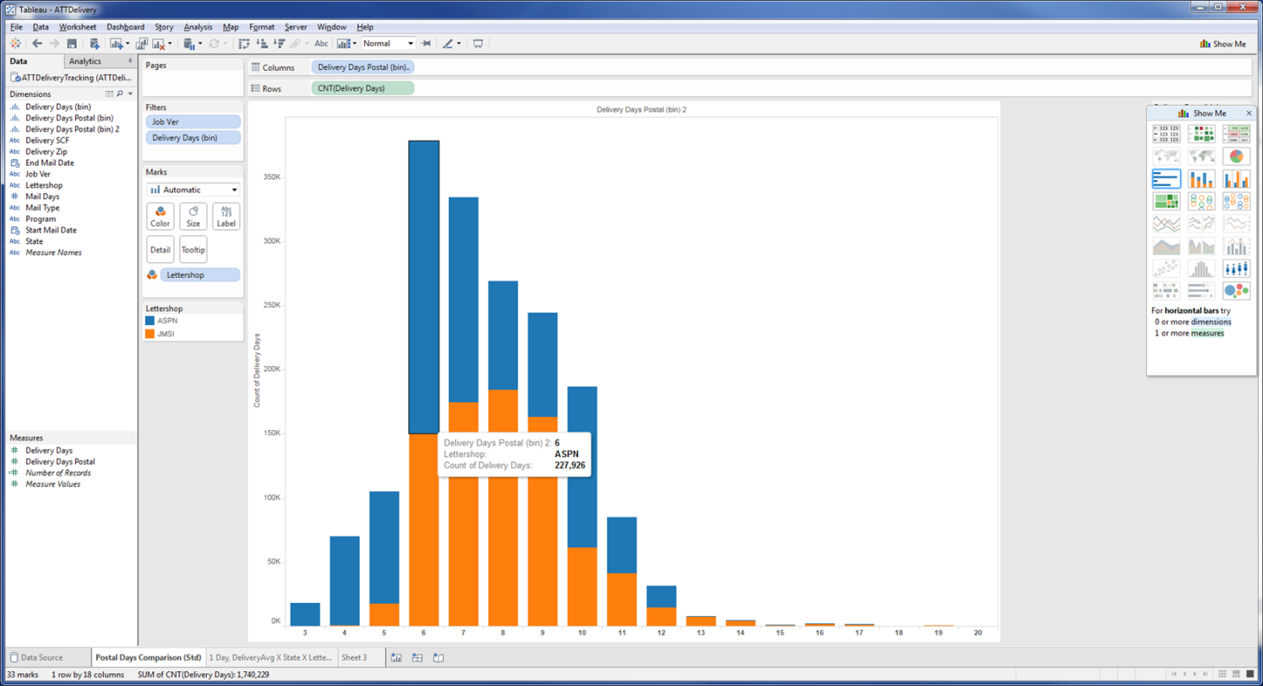
Tableau (cont’d)

Slide 8
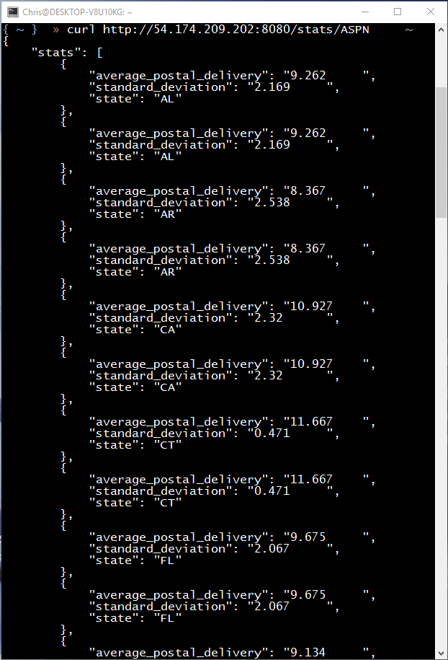
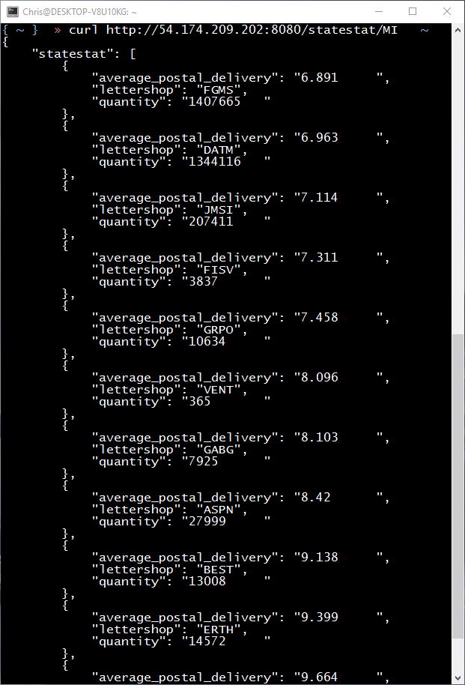
Rest API

Slide 9
Approach to Analysis
Use EC2 Instance in Amazon Web Services
Hadoop / Hive
Cloudera/Hiverserver2 for integration with Tableau
Analyze volume, speed, and speed consistency to each of the 50 states
Identify which shipping centers deliver to which states the fastest
Rank each Shipping Center by volume and performance (speed of delivery)
i.e. Zip Code 72205
Shipping Center 1
5.6 Days
Shipping Center 2
6.8 Days

Slide 10
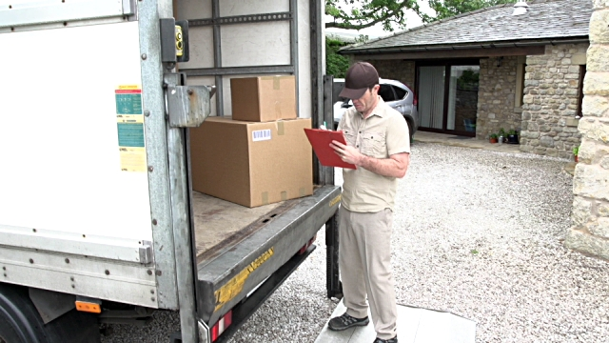
Conclusion
Ship Smarter
By Performing This Analysis
Our company could finally answer the following questions:
Each production center is faster in some states and slower in others
There is no simple answer
Who’s the fastest? It depends on where the mailing is going
Next features will include:
A report card we can share with each distribution center
Ability to upload a mail file and it will select the best production ctr
More Rest API calls
Chron job to schedule uploads and exports to PostgreSQL

